Slide 1
REST API Documentation
Olivier Liechti & Simon Oulevay
COMEM Web Services 2016

Slide 2
API Documentation
When you are designing and implementing a REST API, you are most often doing it for third-party developers:
  Think about Twitter, Instagram or Amazon exposing services to external developers.
  Think about an enterprise (e.g. car manufacturer) exposing services to business partners (e.g. suppliers, subcontractors, distributors).
The documentation of your API is the first thing that third-party developers (your customers) will see. You want to seduce them.
The documentation of your API will have a big impact on its learnability and ease of use.
Best practices and tools have emerged. Evaluate and apply them!

Slide 3
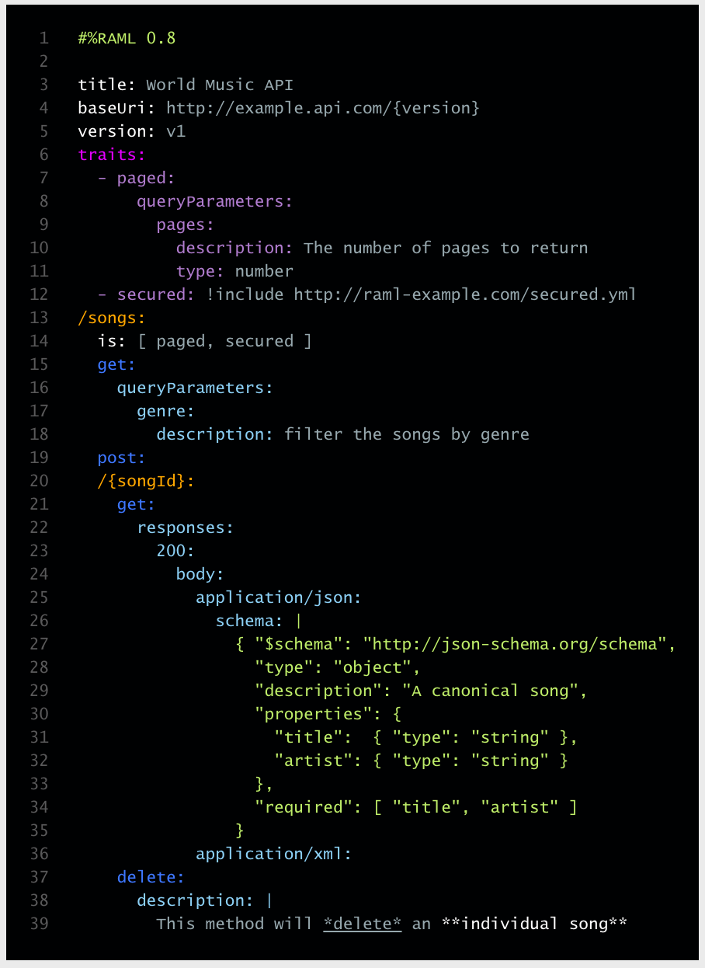
RAML
RESTful API Modeling Language
RAML is a language that has been developed to facilitate the design and documentation of REST APIs.
It allows you to describe resources, methods, parameters, headers and payloads in a succinct manner (support for abstraction and reuse).
From a RAML file, it is possible to generate a user-friendly documentation (e.g. in HTML) with various tools.
Other tools support import/export exchange with REST frameworks (e.g. JAX-RS).

Slide 4
RAML
RAML is pretty straightforward to use:
  You describe the list of resources managed by your application, document the support HTTP verbs, enlist the query parameters, etc.
  If you use Sublime Text, you can take advantage of an extension that provides syntax highlighting.
  See RAML 100 tutorial (http://raml.org/docs.html)
RAML has advanced features that can make your specifications less verbose (by abstracting and reusing common elements):
  includes
  resource types and schemas
  traits
  See RAML 200 tutorial (http://raml.org/docs-200.html)

Slide 5
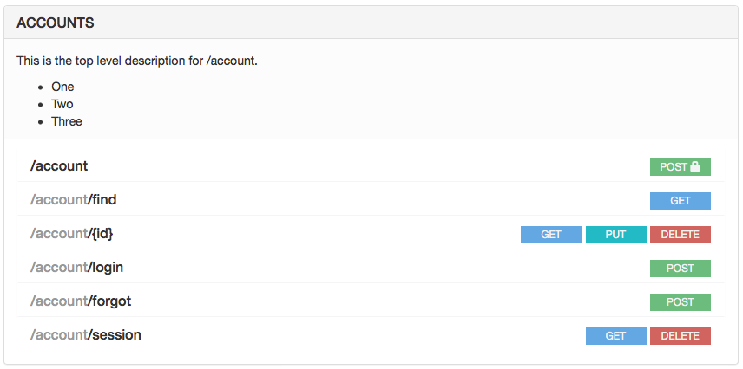
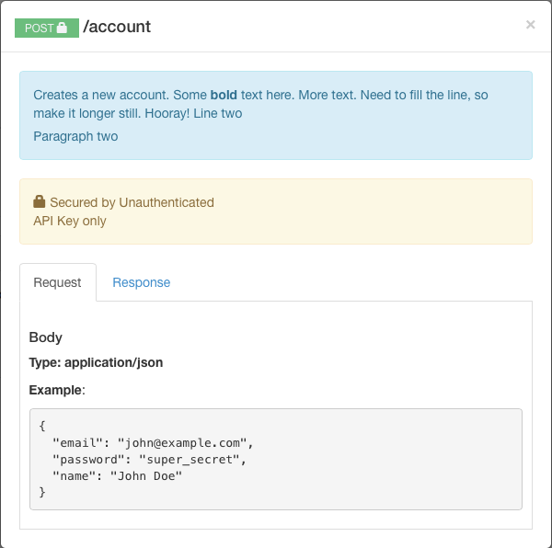
Convert RAML to HTML
https://rawgit.com/raml2html/raml2html/master/examples/example.html

Slide 6
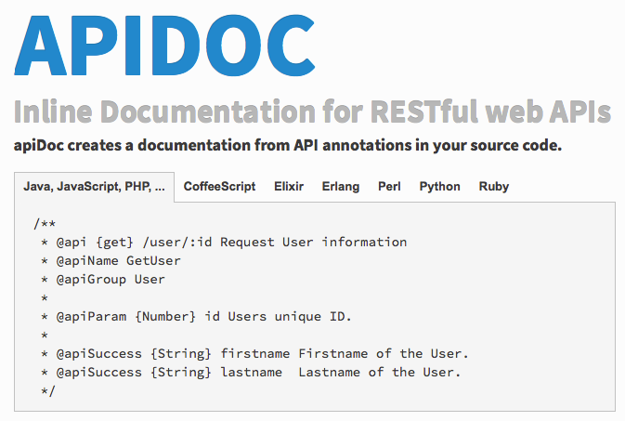
APIDOC

Slide 7
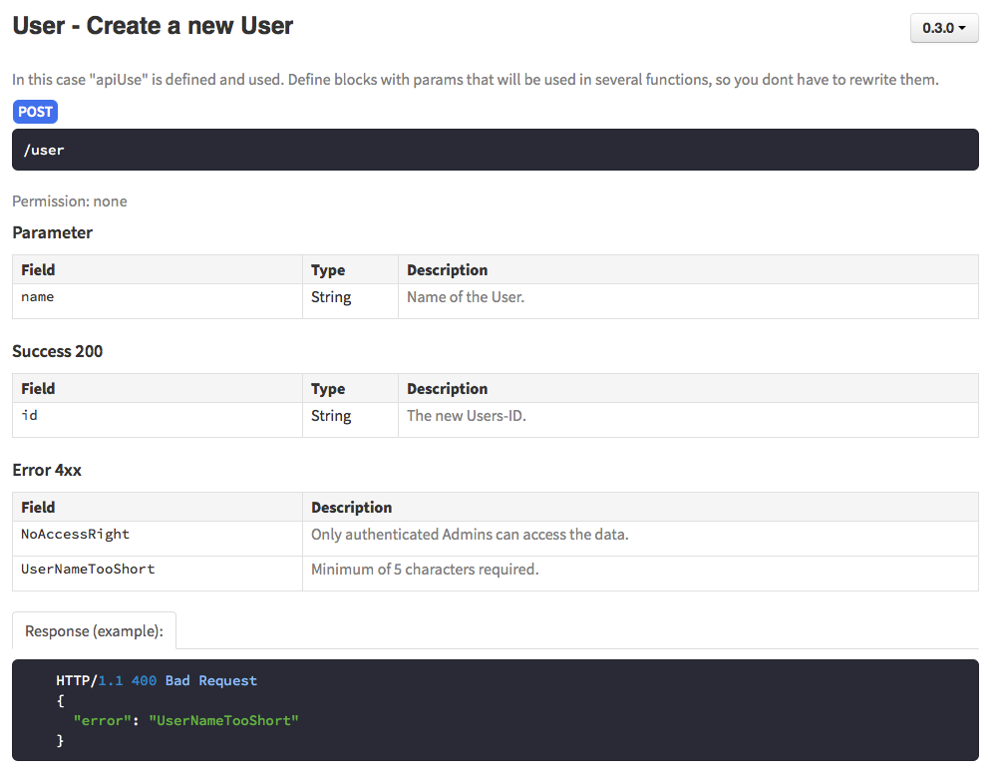
Generate HTML from APIDOC
http://apidocjs.com/example/

Slide 8

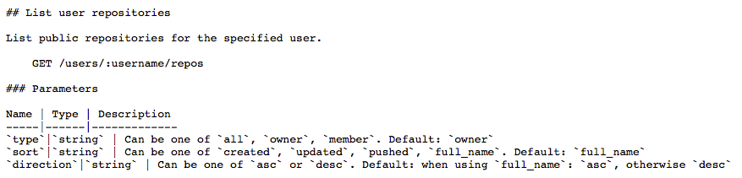

Custom example: GitHub API
Written in Markdown, an easy-to-read, easy-to-write plain text format.
Rendered to HTML with nanoc, a static website generator written in Ruby.

Slide 9
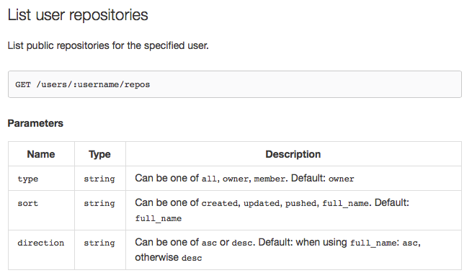
Custom example: GitHub API
https://developer.github.com/v3/

Slide 10

Don't forget Grunt
RAML to HTML with Grunt
https://github.com/cybertk/grunt-raml2html
APIDOC to HTML with Grunt
https://github.com/apidoc/grunt-apidoc

Slide 11
API documentation examples
https://developer.github.com/v3/
https://dev.twitter.com/rest/public
https://developers.facebook.com/docs/graph-api
https://www.instagram.com/developer/

